Slide 1
Lecture 07: Strings
Understand how strings are organized, working with strings, and explore various string methods
Kok-Seng Wong | 2021

Slide 2
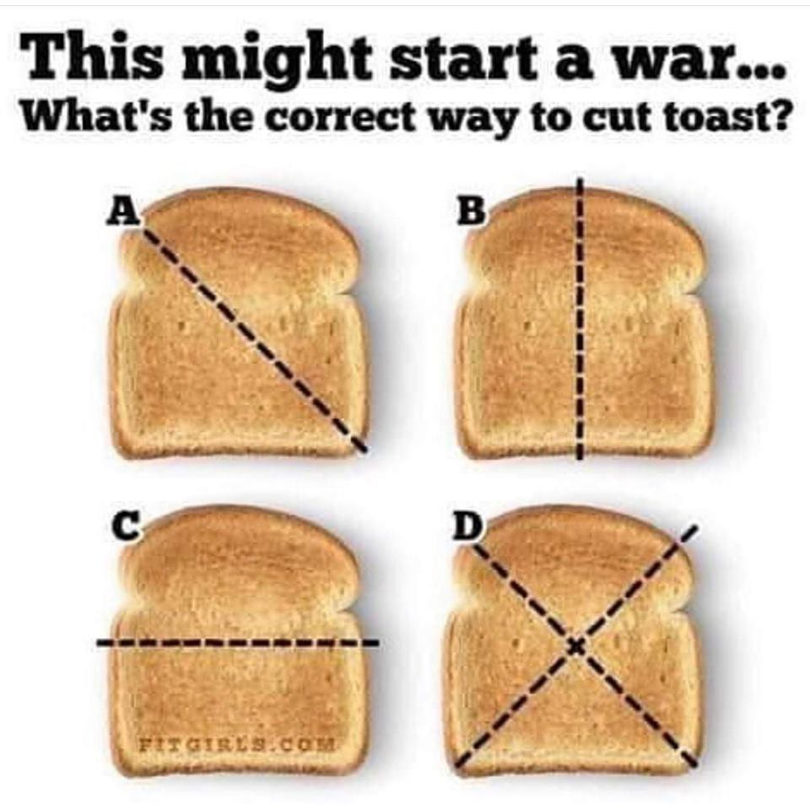
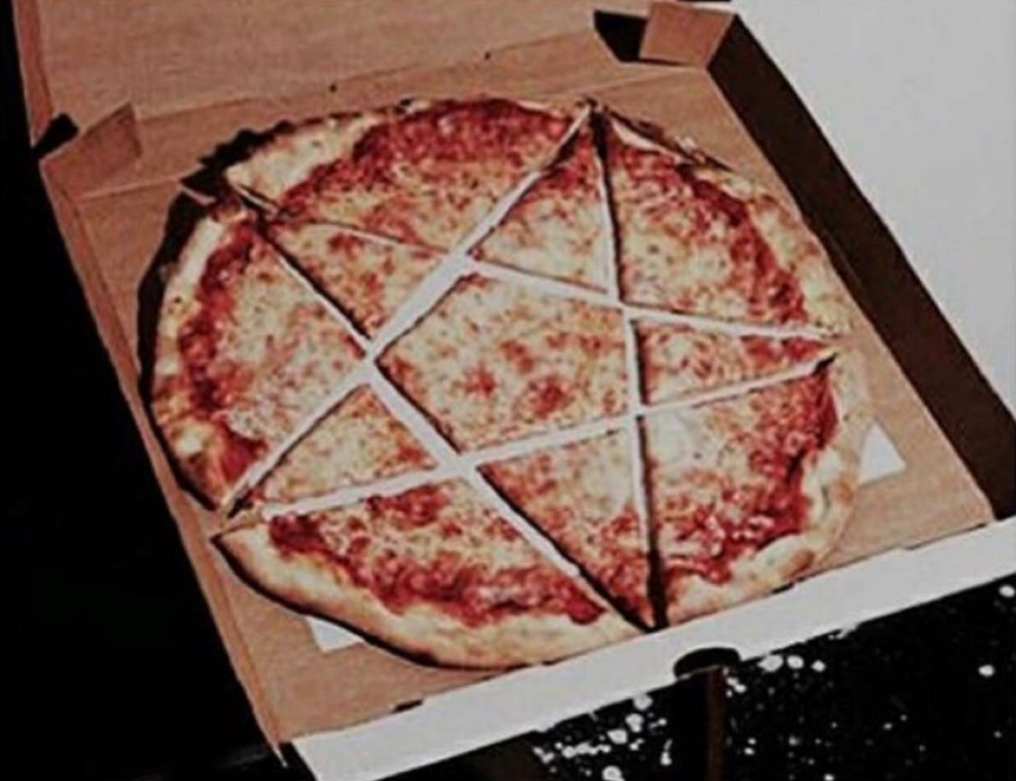
Motivation Examples 1
[source]
[source]

Slide 3
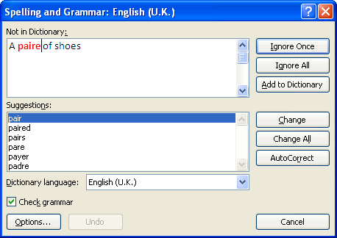

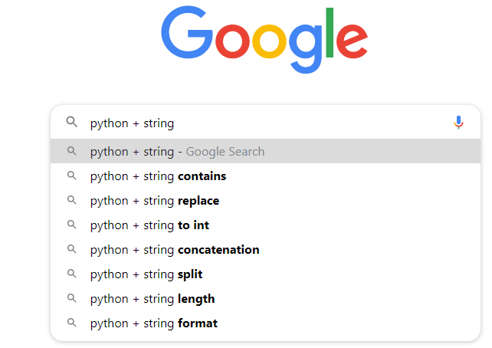
Motivation Examples 2
String matching for real world problems:
Spell Checkers
Spam Filters
Search Engines
Plagiarism Checkers
Information Retrieval
etc.

Slide 4
Learning outcomes
Upon the completion of this lecture, students will be able to:
explain and relate the important of strings manipulation in real world applications.
understand and apply string slicing methods to create a substring from the source string and original string.
use different operators and built-in methods that work with strings.

Slide 5
sequence
Basic data structure in Python.
Each element of a sequence is assigned a number: index or position
There are six types of sequence:
Strings
Unicode strings
Lists
Tuples
Buffers
xrange objects

Slide 6
strings
A sequence of case sensitive characters.
Operators: ==, >=, <=, >, < etc.
len(): a function used to retrieve the length (or size) of the string.
Evaluates to an int
m | i | c | k | y
>>> s = "micky"
>>> len(s)
5
five characters

Slide 7
Strings are indexed
x = "mouse“
We can access each character in x using []
x[0] | m
x[1] | o
x[2] | u
x[3] | s
x[4] | e
x[-5]
x[-4]
x[-3]
x[-2]
x[-1]
x[5]
index: always starts at 0
0 | 1 | 2 | 3 | 4
m | o | u | s | e
-5 | -4 | -3 | -2 | -1
index: last element always at index -1

Slide 8
String slicing
Slice string with [start:stop:step]
If [start:stop], by default step=1
Can omit numbers and use just colons:
x[1:4:2]
"os"
0 | 1 | 2 | 3 | 4
m | o | u | s | e
-5 | -4 | -3 | -2 | -1
0 | 1 | 2 | 3 | 4
m | o | u | s | e
2-step
x[0:4]
"mous"
0 | 1 | 2 | 3 | 4
m | o | u | s | e
x[:]
Same as x[0:len(x)]
x[::]
Same as x[0:len(x):1]

Slide 9
Class practice
0 | 1 | 2 | 3 | 4
m | o | u | s | e
-5 | -4 | -3 | -2 | -1
x[:]
x[::]
x[::-1]
x[0:4]
x[4:1:-2]
x[1:4:2]
x[3::-2]

Slide 10
Class practice
0 | 1 | 2 | 3 | 4
m | o | u | s | e
-5 | -4 | -3 | -2 | -1
len(x[:])
len(x[::])
len(x[::-1])
Len(x[0:4])
len(x[4:1:-2])
len(x[1:4:2])
len(x[3::-2])

Slide 11
Strings are immutable
Cannot modified the elements in a string:
But strings can bound to a new object:
strings and tuples are immutable but, lists and dictionaries are mutable.
y = "Hello"
y[0] = "M"
y = "M" + y[1:len(y)]
print(y)
"Mello"

Slide 12
Class practice
a = "Micky Mouse"
b = "Donald Duck"
c = "Bruce Lee"
a = a[0] + b[1:4] + c[5:7] + "isa"
print(a)
Output:

Slide 13
Class practice
a = "Micky Mouse"
b = "Donald Duck"
c = "Bruce Lee"
b = b[-6::-1] + a[-9::-2]
c = c[6:10] + a[5] + "loves " + b[::-1]
print(c)
Output:

Slide 14
String “in” Operator
Operator: in
To test if str1 is a substring of str2
Evaluates to a bool
>>> str1 = "I'm selling apple, orange, durian, banana!"
>>> str2 = "banana"
>>> str2 in str1
True
>>> "Orange" in str1
False
>>> "m" in str2
False
>>> "" in str1
True
Python has not in operator too!

Slide 15
String “is” Operator
Operator: is
To check if both str1 and str2 refer to the same object
Evaluates to a bool
>>> str1 = "durian"
>>> str2 = str1[1:2]
>>> str2 is str1
False
>>> str3 = str1[:]
>>> str3 is str1
True
>>> id(str1)
1882887600560
>>> id(str3)
1882887600560

Slide 16
Class practice
>>> str1 = "racecar"
>>> str2 = str1[::-1]
>>> str1 in str2

Slide 17
String methods
Python has a set of built-in methods that we can use on strings.
All string methods returns new values. They do not change the original string.
Format:
Some popular string methods:
<string name>.<method name>(x,y,…)
upper(), index(), count(), isupper(), strip(), etc.
Complete list: https://docs.python.org/2.4/lib/string-methods.html

Slide 18
String methods example 1
String method:
isupper()
returns True if all characters in the string are upper case
upper()
converts a string into upper case
>>> s1 = "HELLO"
>>> s1.isupper()
True
>>> s2 = "world"
>>> s2.upper()
'WORLD'
>>> s1 + " " + s2
'HELLO world'

Slide 19
String methods example 2
String method:
s3 = "Ali Baba"
index()
searches the string for a specified value and returns the position of where it was found
A | l | i |  | B
a | b | a
0 | 1 | 2 | 3 | 4
5 | 6 | 7
>>> s3.index("A")
>>> s3.index(" ")
>>> s3.index("a")
>>> s3.index("aba")
>>> s3.index("z")
>>> s3.index("i",0, 2)
?
?

Slide 20
String methods example 3
String method:
s3 = "Ali Baba"
count()
return the number of times a specified value occurs in a string
0 | 1 | 2 | 3 | 4
5 | 6 | 7
A | l | i |  | B
a | b | a
>>> s3.count("A")
>>> s3.count(" ")
>>> s3.count("a")
>>> s3.count("aba")
>>> s3.count("z")
?

Slide 21
String methods example 4
String method:
s4 = "Ali Baba "
strip([chars])
returns a copy of the string with the leading and trailing characters removed.
A | l | i |  | B
a | b | a
>>> s4.strip()
'Ali Baba'
>>> s4.strip("A")
'li Baba '
>>> s4.strip("A a")
'li Bab'
>>> s4.split(" ")
['Ali', 'Baba', '']

Slide 22
Class practice
>>> x = "Harry Potter"
>>> y = x.strip("Hter")
>>> y.strip("o yP")
>>> "cat,dog,snack".split(",")

Slide 23
String methods example 5
String method:
s5 = "Ali Baba "
replace()
returns a string where a specified value is replaced with another value
A | l | i |  | B
a | b | a
>>> s5.replace("Ali", "James")
'James Baba '
J | a | m | e | s
 | B | a | b | a

Slide 24
Class practice
>>> friend = "Ali Baba"
>>> friend.replace("a", "o")
>>> friend.replace("li", "my")
>>> friend.replace("", "-")
>>> friend.replace(" ", "&")

Slide 25
String methods example 6
String method:
s6 = "V20205222“
Other methods: isalpha(),isalnum(),isdigit(),isdecimal()…
isnumeric()
returns True if all characters in the string are numeric characters
>>> s6.isnumeric()
False
>>> s6[1:len(s6)-1].isnumeric()
True
More details: https://docs.python.org/3.4/library/stdtypes.html?highlight=strip

Slide 26
String methods example 7
capitalize()
returns a copy of string with the first character converted to uppercase and all other characters converted to lowercase
>>> S7 = "heLLO aLI"
>>> s7.capitalize()
'Hello ali'
title()
returns a copy of string with the first character of each word converted to uppercase and all other characters converted to lowercase
>>> s7.title()
'Hello Ali'

Slide 27
String: text as a value
Strings are written as quoted characters:
How to write quotes in quotes?
Use escape charters:
'Hellow World!' (Python prefers)
"Hellow World!" (most programming languages)
'"' or "'"
Both " and '
Char | Description
\' | Single quote
\" | Double quote
\n | New line
\t | Tab
\\ | backslash

